Slide 1


SRI RAMAKRISHNA ENGINEERING COLLEGE [Educational Service : SNR Sons Charitable Trust] [Autonomous Institution, Accredited by NAAC with ‘A’ Grade] [Approved by AICTE and Permanently Affiliated to Anna University, Chennai] [ISO 9001-2015 Certified and all eligible programmes Accredited by NBA] VATTAMALAIPALAYAM, N.G.G.O. COLONY POST, COIMBATORE – 641 022.
MINI PROJECT
Model Compression Techniques for Improved
Handwritten Digit Recognition
Work By,
AJEEM KHAN K(CSE 2201013)
ENITHA S(CSE 2201047)
SWETHA T(2201239)
Guided By,
Mrs.A.Mahalakshmi (Assistant. Prof. CSE)

Slide 2
CONTENTS
INTRODUCTION
LITERATURE SURVEY
PROBLEM STATEMENT
OBJECTIVES
METHODOLOGY
MODULES
SOFTWARE REQUIREMENTS
RESULTS AND DISCUSSION
REFERENCES

Slide 3
INTRODUCTION
Handwritten digit recognition is a crucial task in computer vision and machine learning, with applications spanning OCR, document processing, and data entry automation.
While CNNs have excelled in this domain, their deployment on resource-constrained devices poses challenges due to high computational demands.
Multilayer perceptrons (MLPs) offer competitive performance, but their deployment on edge devices remains prohibitive.
This study explores the application of quantization and pruning techniques to compress MLP models for handwritten digit classification, addressing the challenge of limited device resources.
Our investigation delves into the impact of various loss functions on compression performance, offering insights into effective strategies for deploying compact MLP models without sacrificing accuracy.

Slide 4
LITERATURE SURVEY

Slide 5
LITERATURE SURVEY(I)
"A Survey on Low-Bit Quantization for Deep Neural Network Inference" by Yiqun Gu, Xunyu Xie, Xin Dong, and Yuan Xie, August 2022
Review recent advancements in low-bit quantization for efficient DNN inference.
Address challenges of deploying DNNs on resource-constrained devices due to increasing model complexity.
Introduce problem formulation, discuss quantization schemes and methods for different network components, and review quantization-aware training techniques.
Low-bit quantization as a promising approach, various quantization schemes, techniques to mitigate accuracy degradation, and considerations for hardware architecture design.
Enhancing efficiency of DNN inference through low-bit quantization.
Highlight open problems and areas for future research in low-bit quantization for DNNs.

Slide 6
LITERATURE SURVEY(II)
"Quantization of Deep Convolutional Networks for Efficient Inference: A Survey" by Jiquan Ngiam et al, June 2018
Explore network quantization methods to enhance efficiency of deep CNN inference.
Deep CNNs are widely used but face challenges in resource-constrained scenarios due to high computational complexity and memory footprint.
Comprehensive survey categorizing and analyzing quantization schemes, including linear and non-linear methods.
Evaluation of quantization for different CNN components (weights, activations, gradients) and discussion of quantization-aware training techniques.
Importance of network quantization for efficient inference and strategies to mitigate accuracy loss.
Identification of open problems and suggestions for future research in network quantization.

Slide 7
LITERATURE SURVEY(III)
"A Survey on Neural Network Quantization" by Markus Nagel et al, August 2020
Provide an overview of neural network quantization techniques to address computational and memory challenges in DNNs.
High computational cost and memory footprint of DNN models necessitate efficient quantization techniques.
Comprehensive examination of quantization methods for weights, activations, and gradients, along with hardware-aware approaches.
Discussion on fundamental concepts, key classification criteria, evaluation metrics, and insights into efficient implementation.
Highlight potential for hardware/software co-design and importance of quantization for reducing model size and compute requirements.
Summarize key insights and outline areas for future research in neural network quantization.

Slide 8
LITERATURE SURVEY(IV)
"Pruning Convolutional Neural Networks for Resource Efficient Inference" by Hao Li et al
The paper by Li, Cai, Chen, and Dally addresses the pressing need for resource-efficient inference, particularly in the realm of convolutional neural networks (CNNs).
Their method focuses on identifying and removing redundant filters and connections in CNNs to achieve significant model compression without sacrificing inference accuracy.
A novel fine-tuning strategy is introduced post-pruning to effectively mitigate any loss in performance.
Extensive experimentation spanning different CNN architectures and datasets showcases the robustness and effectiveness of their approach.
The implications extend beyond theoretical advancements, offering practical solutions for deployment in edge devices and other resource-constrained platforms, where efficient inference is paramount for real-time applications

Slide 9
LITERATURE SURVEY(V)
"Rethinking the Value of Network Pruning" by Zhuang Liu et al
The paper by Liu, De Sa, van der Maaten, and Tang offers a critical evaluation of network pruning techniques in deep learning, challenging prevailing beliefs about their efficacy.
Contrary to common assumptions, the authors argue that pruning alone may not always lead to significant gains in efficiency and performance.
They propose a holistic approach that considers the intricate trade-offs between pruning-induced sparsity and computational efficiency.
Through rigorous empirical studies across various architectures and datasets, the authors highlight the nuanced effects of pruning, emphasizing the importance of carefully designing pruning strategies aligned with specific optimization objectives and constraints.
This reevaluation prompts a fundamental shift in the approach to network pruning, advocating for context-aware methodologies that account for the complex interactions between sparsity, performance, and efficiency.

Slide 10
PROBLEM STATEMENT
Current research overlooks alternative loss functions beyond cross-entropy for compressing MLPs in digit recognition.
The study targets efficient MLP models for classification using quantization and pruning techniques.
It explores MSE, hinge loss, weighted cross-entropy, and focal loss.
This research addresses a gap in understanding model optimization for digit recognition

Slide 11
OBJECTIVES
Train and evaluate a baseline MLP model on the handwritten digit dataset to establish a performance benchmark.
Apply quantization techniques and pruning algorithms to compress the trained MLP model, exploring various loss functions (MSE, hinge, weighted cross-entropy, focal loss) during compression.
Evaluate the compressed models using comprehensive metrics, including average accuracy, per-class precision, recall, loss values, and confusion matrices, to analyze trade-offs between compression ratio, accuracy, and loss function choice.

Slide 12
METHODOLOGY
Handwritten Digits Dataset: Contains images and labels of handwritten digits.
Model Training: Establishes a baseline MLP model.
Quantization and Pruning Modules: Apply techniques to reduce model size and explore various loss functions.
Evaluation Module: Assesses model performance comprehensively, guiding deployment strategies for compact MLP models on resource-constrained devices.

Slide 13
MODULES
MODULE 1: MLP Model Training
We establish a baseline MLP model on handwritten digit data for performance comparison.
MODULE 2: Quantization Techniques
Exploration of techniques to reduce weight and activation precision in the MLP model, assessing various quantization levels and loss functions.

Slide 14
MODULES
MODULE 3: Pruning
Pruning algorithms are used to sparsify the MLP model by removing redundant weights, exploring various criteria. The effects of different loss functions (MSE, hinge, weighted cross-entropy, focal loss) are analyzed during pruning.
MODULE 4: Analysis
A comprehensive evaluation of the baseline MLP model, quantized models, and pruned models is conducted. Various metrics are utilized to provide insights into effective model compression techniques and loss function choices for deploying lightweight MLP models on edge devices for handwritten digit recognition.

Slide 15
SOFTWARE REQUIREMENTS
Operating System : Windows 10 +
Environment : Jupyter notebook
Language : Python
Python version : 3 . x
Dependencies installation : NumPy, PANDAS, matplotlib

Slide 16
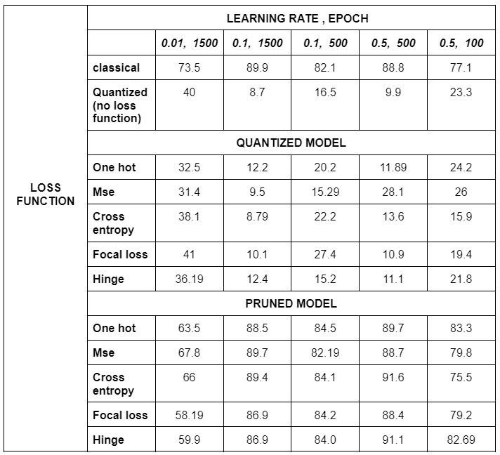
RESULTS AND DISCUSSION
ACCURACY COMPARISON

Slide 17
RESULTS AND DISCUSSION
The classical (unpruned, unquantized) model achieves the highest accuracy across all configurations, demonstrating the importance of using a traditional training approach for optimal performance.
Quantization without a specific loss function results in significantly lower accuracy compared to the classical model, highlighting the necessity of choosing an appropriate loss function during the quantization process.
The Focal loss and Hinge loss models among the quantized models show the best performance, indicating the suitability of these loss functions for quantization.
Pruned models consistently outperform quantized models across all configurations, demonstrating the effectiveness of pruning in preserving model performance while improving efficiency.
The pruned One-hot model achieves the highest accuracy among pruned models, indicating the success of pruning in maintaining or even surpassing the accuracy of the classical model in some cases.

Slide 18
CONCLUSION
The choice of loss function during quantization significantly impacts model performance, with the absence of a specific loss function resulting in notably lower accuracy compared to the classical model.
Among quantized models, the Focal loss and Hinge loss functions demonstrate superior performance, indicating their effectiveness in preserving model accuracy during quantization.
Pruned models consistently outperform quantized models across all configurations, with the pruned One-hot model achieving accuracy approaching that of the classical model.
The effectiveness of pruning in mitigating performance degradation caused by quantization suggests its value in improving model efficiency without sacrificing too much accuracy.
Learning rate and epoch configurations greatly influence model performance, with the classical model benefiting from higher learning rates and moderate epoch counts, while quantized models with appropriate loss functions exhibit more stable performance across different settings.
The findings emphasize the importance of selecting suitable loss functions, leveraging pruning techniques, and carefully tuning hyperparameters for the design and optimization of efficient machine learning models for various applications.

Slide 19
REFERENCES
[1]. "A Survey on Low-Bit Quantization for Deep Neural Network Inference" by Yiqun Gu, Xunyu Xie, Xin Dong, and Yuan Xie, August 2022
[2]."Quantization of Deep Convolutional Networks for Efficient Inference: A Survey" by Jiquan Ngiam et al, June 2018
[3]. "A Survey on Neural Network Quantization" by Markus Nagel et al, August 2020
[4] “Pruning Convolutional Neural Networks for Resource Efficient Inference” by Hao Li et al[5]
[5] “Rethinking the Value of Network Pruning” by Zhuang Liu et al

Slide 20
THANK YOU

